Slide 1
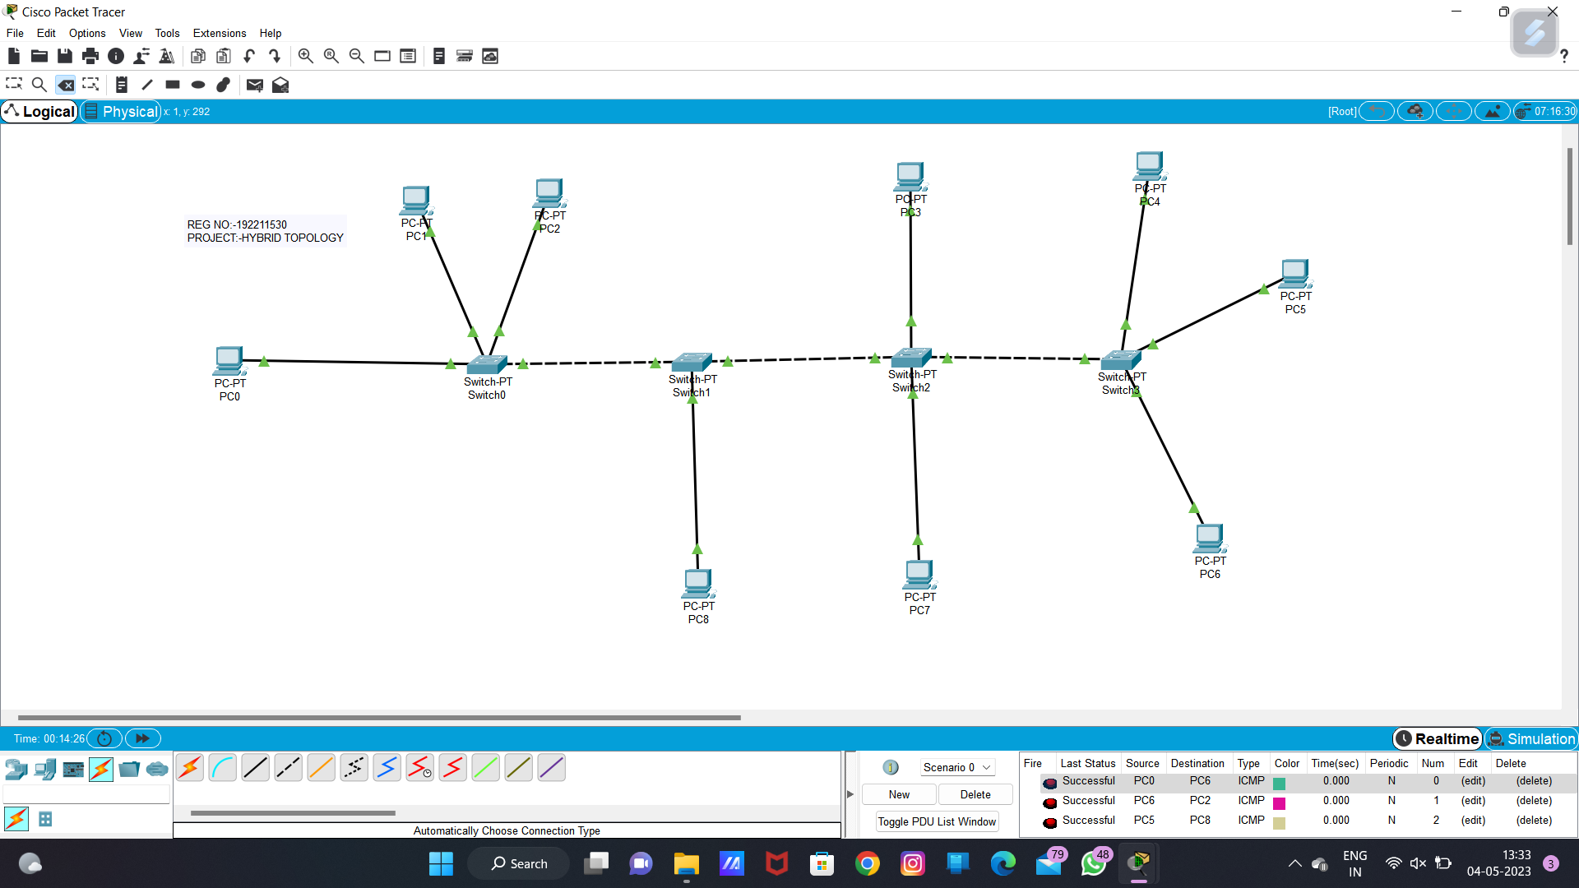

192221078
BHANU.M
Hybrid Topology

Slide 2
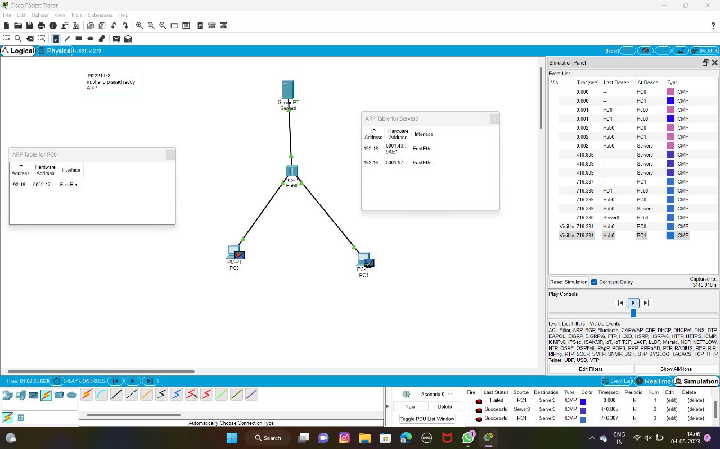
192221078
BHANU.M
ARP

Slide 3
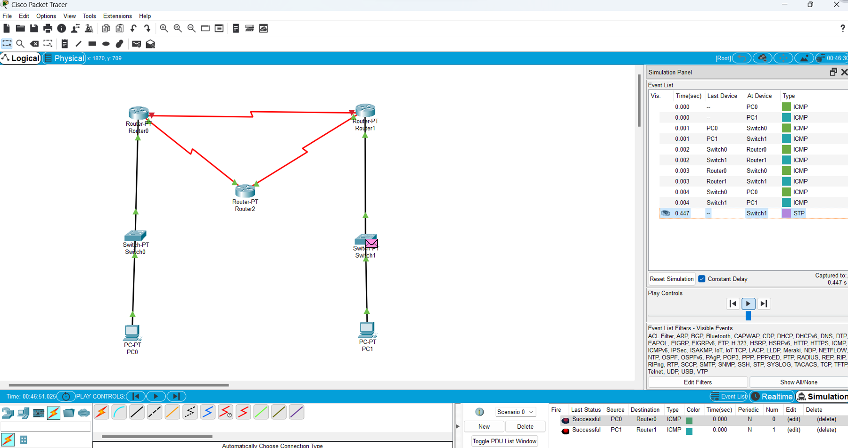
192221078
BHANU.M
Dynamic Routing

Slide 4
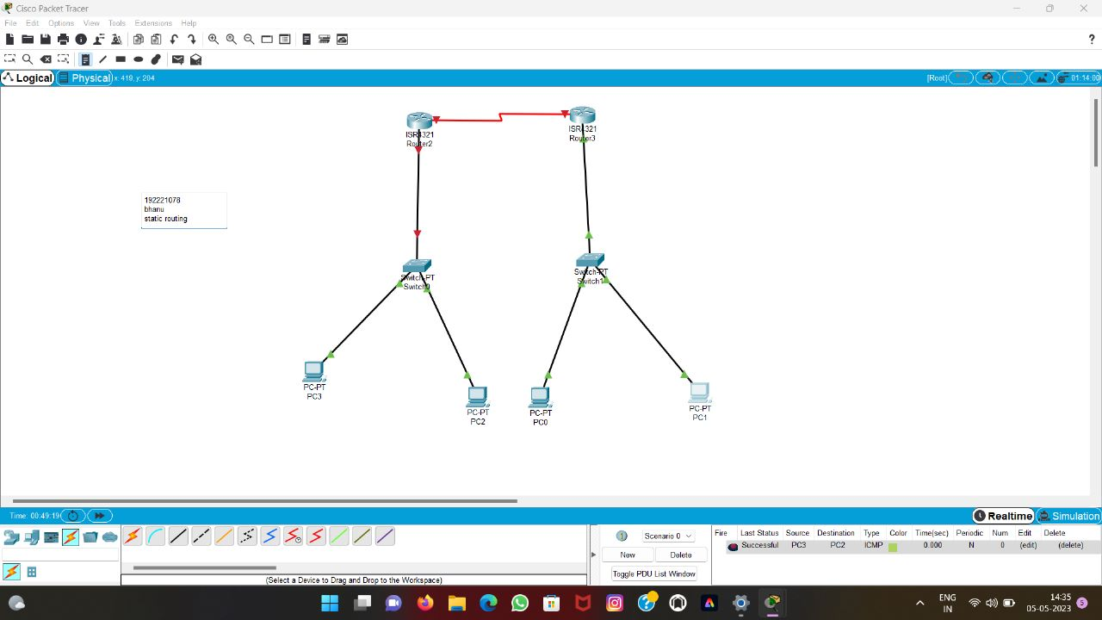
192221078
BHANU.M
Static Routing

